Slide 1
Principles of Art
What we use to organize the elements of art.

Slide 2
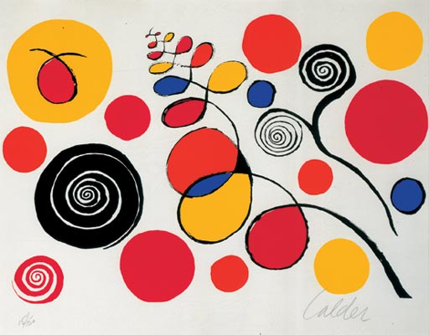
BALANCE: The way elements are arranged to create a feeling of stability in art work

Slide 3
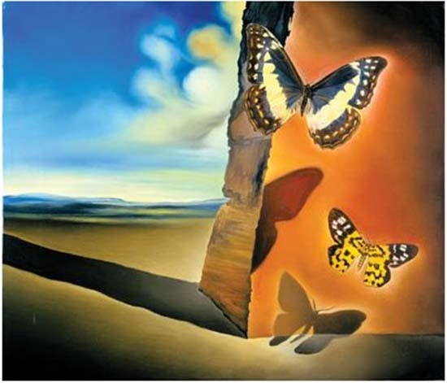
Contrast: The large difference between two elements of art

Slide 4
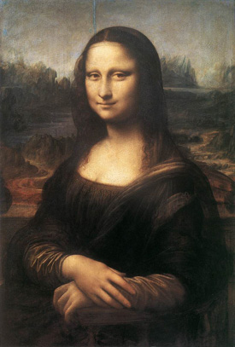
EMPHASIS: Any forcefulness that gives importance or dominance (weight) to some feature or features of an artwork.

Slide 5
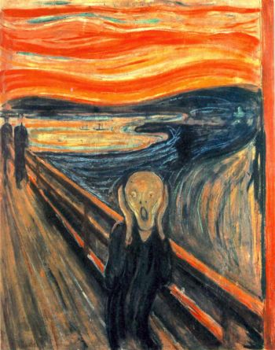
MOVEMENT: the arrangement of the parts of an image to create a sense of motion by using lines, shapes, forms, and textures that cause the eye to move over the work.

Slide 6
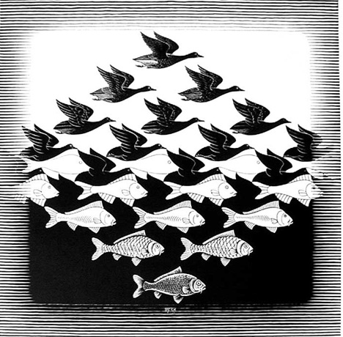
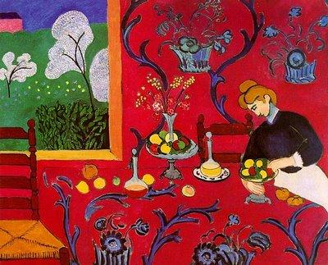
PATTERN: The repetition of any thing — shapes, lines, or colors — also called a motif, in a design

Slide 7
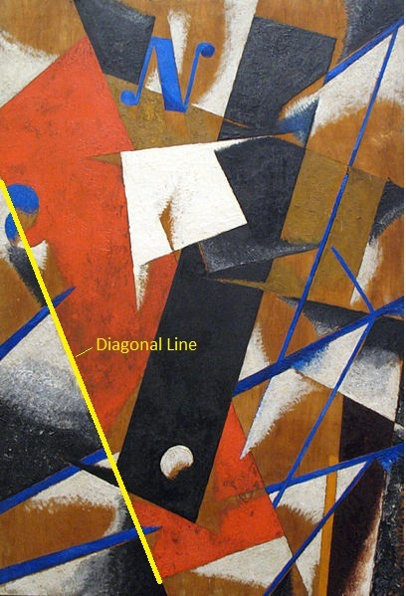
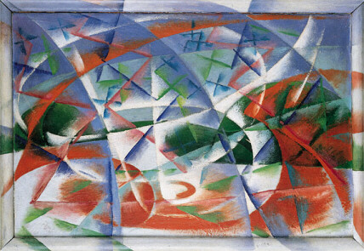
RHYTHM: The regular repetition of elements to produce the look and feel of movement
Giacomo Balla

