Slide 1
Perspective
The technique or process of representing a 3-dimensional scene on a 2-dimensional surface. Perspective gives the illusion of depth or distance.

Slide 2
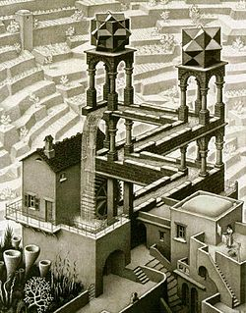
Vocabulary
Linear perspective: a mathematical system for representing 3-dimensional objects and space on a 2-dimensioanl surface

Slide 3
Horizon Line
Horizontal line across an image where the sky and ground meet

Slide 4
Vanishing point
The point of disappearance, or the point at which the orthogonal lines converge

Slide 5
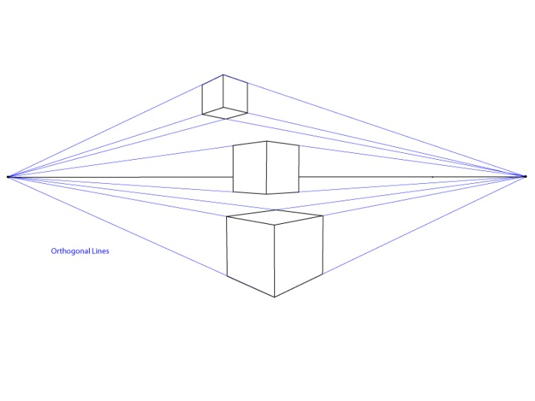
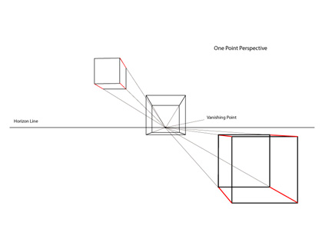
Types of lines you will use
Orthogonal
Lines leading toward the vanishing point
Horizontal
Vertical
Parallel

Slide 6
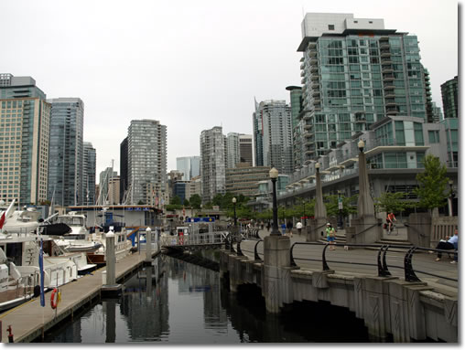
Vocabulary Cont.….
2-dimensional
Having only two dimensions, length and width.
3- dimensional
Having three dimensions, length, width, and depth
Front face
Front of the building
Foreground
Middle Ground
Background

Slide 7
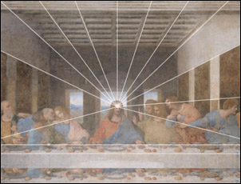
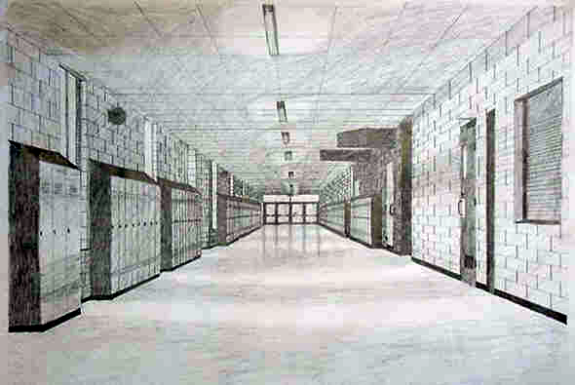
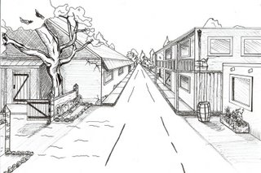
1 Point Perspective
All lines lead to 1 vanishing
point

Slide 8
Activities:
1. https://youtu.be/t_VCgvrhv30
2. Your name in 1 point perspective http://youtu.be/Kgi0nPQEZRE
3. City/landscape in 1point perspective http://youtu.be/MpCwVHXvyQk

Slide 9
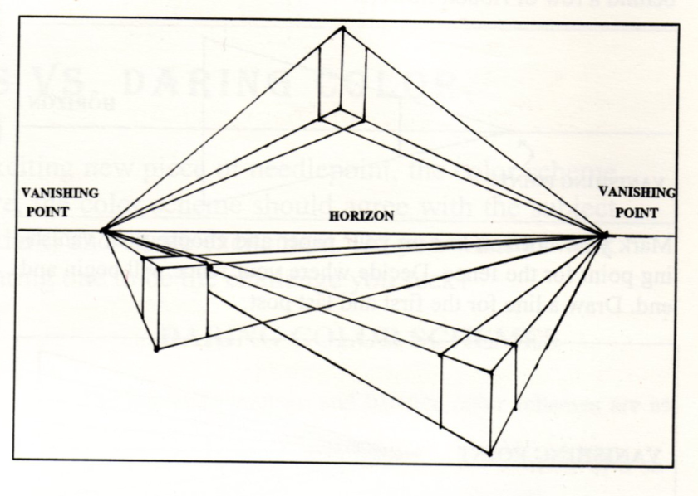
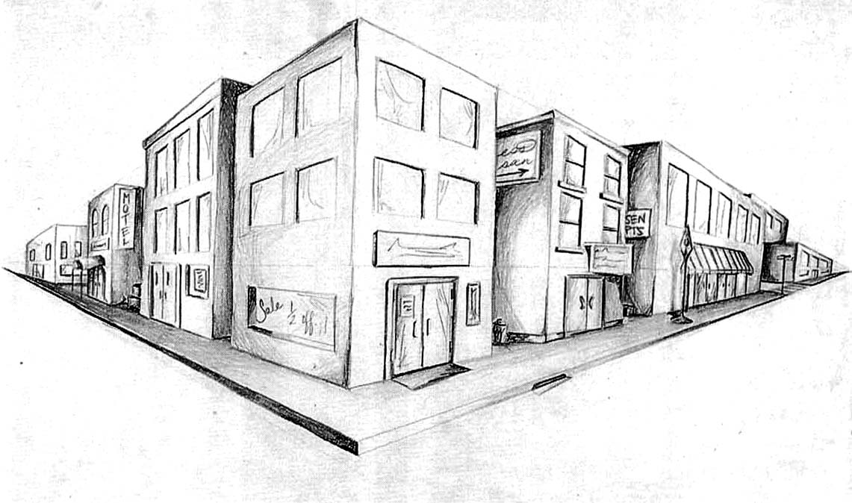
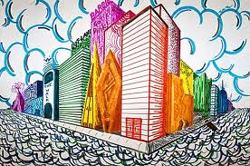
2 Point Perspective http://youtu.be/Cs26klLwv-U

Slide 10
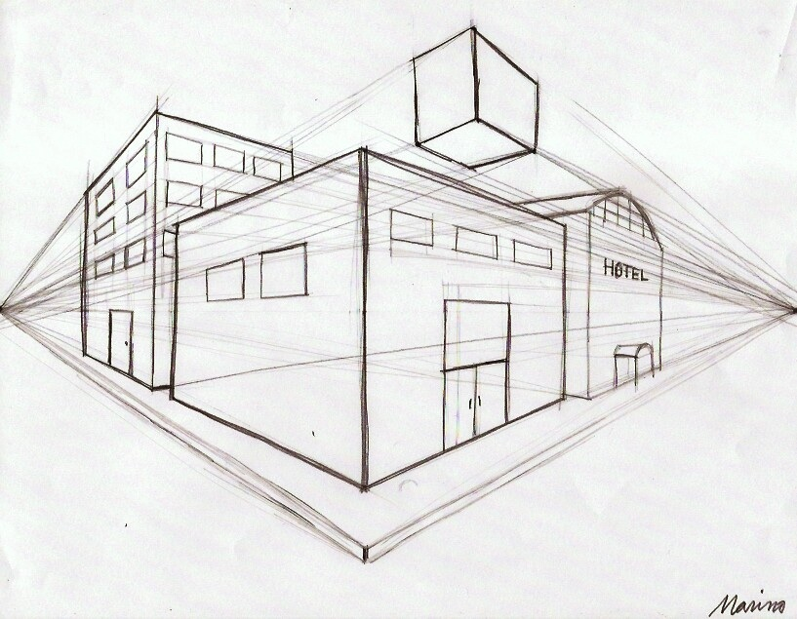
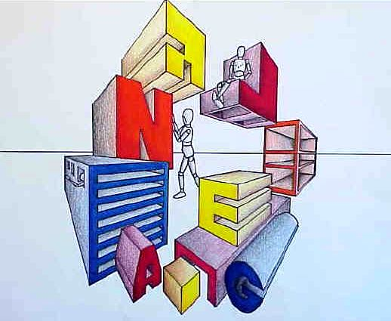
Activity:
Create a 2 point perspective city realistic or fantasy
How is 2 point different than 1 point perspective?

Slide 11
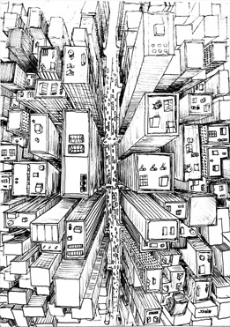
Birdseye view- variation of 1 point
http://youtu.be/V1XoeUKRs0U

Slide 12
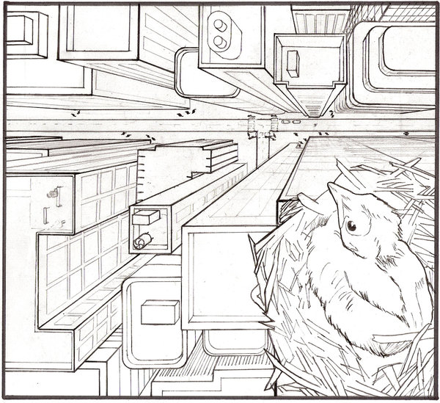
Activity
Create a practice birds eye cityscape

Slide 13
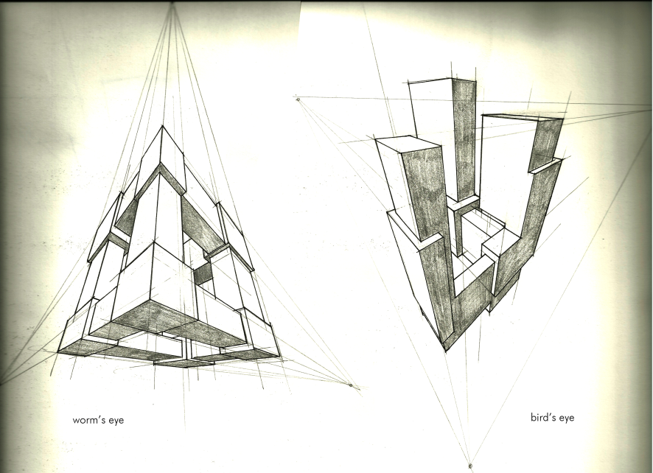
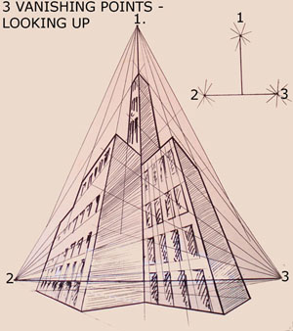
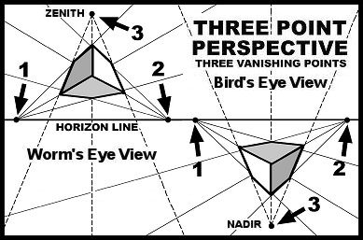
Multiple vanishing points

Slide 14
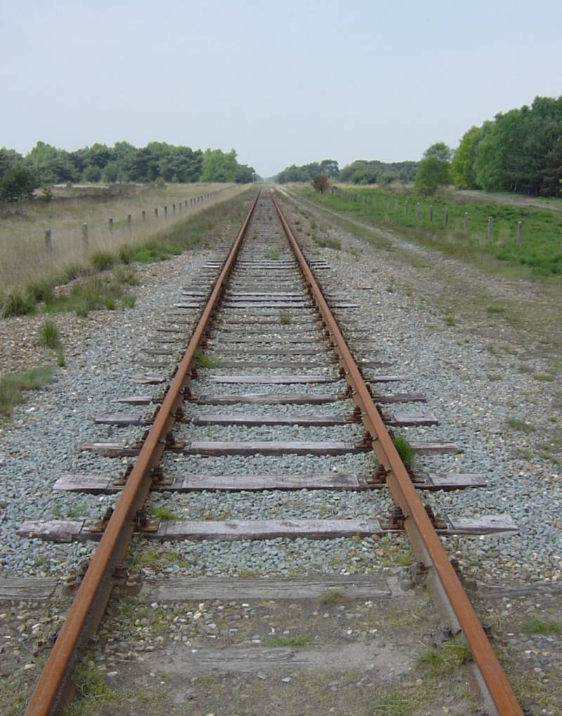
Let’s Review
Look at the following pictures. Identify the horizon line, vanishing point(s), orthogonal lines, and type of perspective.
Let do this one together

Slide 15
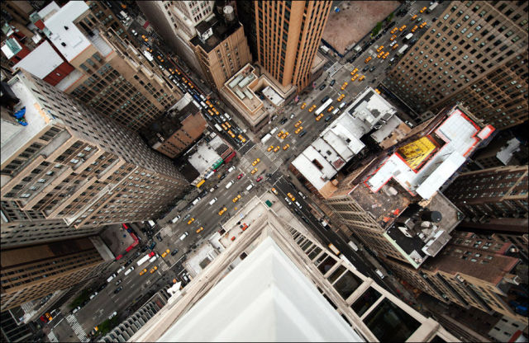

Slide 16
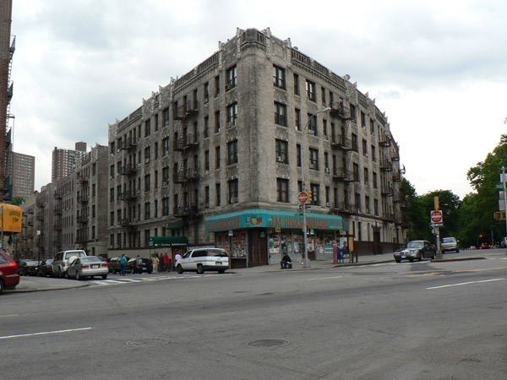

Slide 17
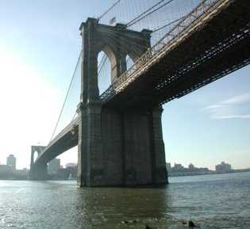

Slide 18
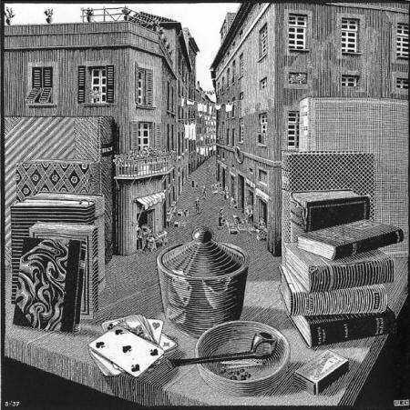

Slide 19
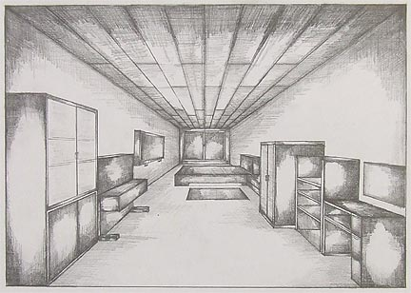

Slide 20
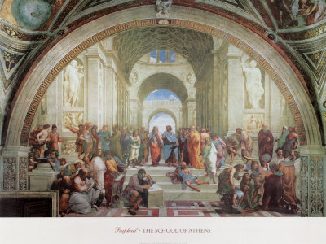

Slide 21
Why is learning to draw perspective important? How will you use it in the future?
Architect
Designer
Illustrator
Photographer
Film maker
Forensic artist
Interior Designer
Landscape architect
Engineers
Artist
Game designer
Industrial Designer
Advertising
Computer animation
Television production and design
Transportation design
Animator
Cartoonist
Children’s book illustrator
Web designer
Art director
Urban Planner
Surveyor
Carpenter
Muralist
Motion Artist
Furniture designer
And many many more!

Slide 22
Your Project
You will create a drawing of a city using 1 type of perspective. The drawing could be realistic or fantasy. In your drawing you must include a minimum of:
8 buildings with windows, doors, and texture
Street
Sidewalk
Landscape around buildings
Value with pencil, sharpie, marker, or colored pencil
Reminders*
Think about what happens to objects as they get father away?

Slide 23
Materials
Drawing paper
Pencil
Your choice of:
- Colored pencil, sharpie, pencil, marker
Ruler
Knowledge of 1 type of perspective- refer to practice handouts if needed

Slide 24
Grading Rubric
30 points/ Use of Perspective
20 points/ Following Directions
20 points/ Use of value
10 points/ Craftsmanship
10 points/ Creativity
10 points/ Daily Effort & Participation
_________/ 100 Project Grade

