Slide 1
Websites
http://www.artlex.com/
http://dictionary.reference.com/browse/art
http://www.princetonol.com/groups/iad/files/elements2.htm

Slide 2
Elements of Art
The building blocks of Art

Slide 3
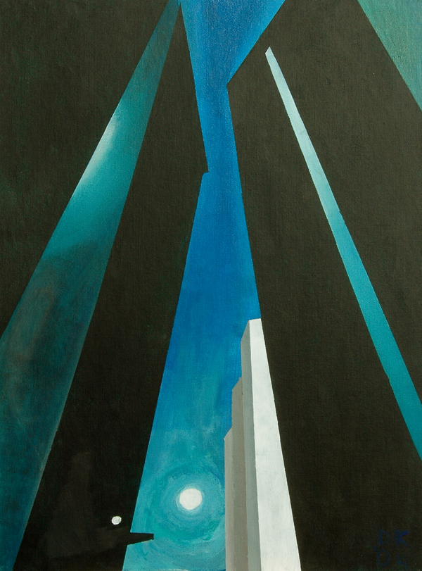
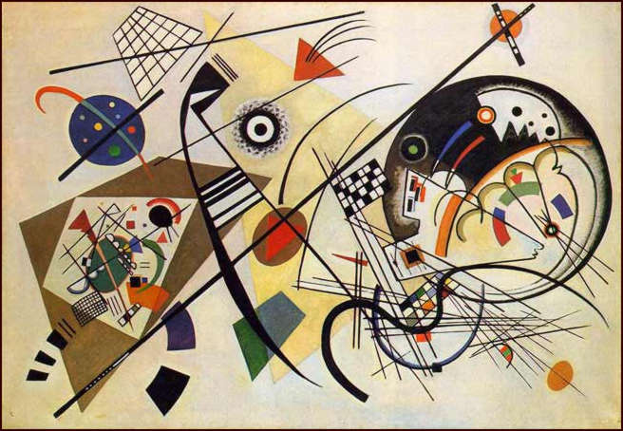
LINE: A mark with length and direction(-s). An element of art which refers to the continuous mark made on some surface by a moving point. Often it defines a space, and may create an outline or contour, It may be two-dimensional (as with pencil on paper) three-dimensional (as with wire) or implied (the edge of a shape or form).
Kandinsky “Transverse line”
1923
Abstract Art- Germany
O'Keeffe
City Scape
1926
Modern

Slide 4
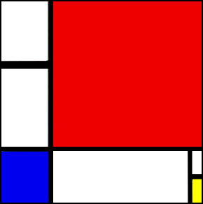
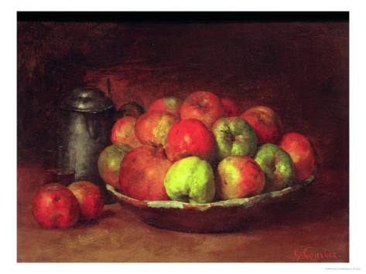
SHAPE: An element of art, it is an enclosed space defined and determined by other art elements such as line, color, value, and texture. In painting and drawing, shapes may take on the appearance of solid three-dimensional object even though they are limited to two dimensions .
Mondrian
“Composition II in Red, Blue, and Yellow”
1930
Non- Representational
Courbet
“Still life with apples
and a pomegranate”
1871
Realism

Slide 5
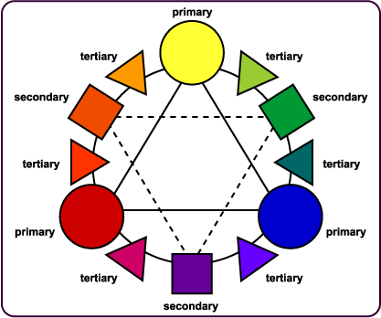
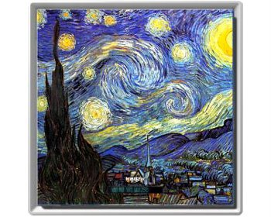
COLOR: Color is the element of art that is produced when light, striking an object, is reflected back to the eye. There are three properties to color. Hue, Value, Intensity. The Color wheel shows how colors relate.
Van Gogh
“Starry Night”
1889
Post- Impressionist

Slide 6
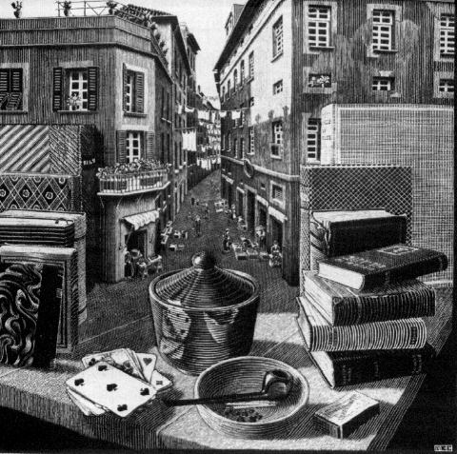
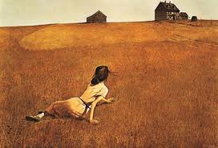
Value: the lightness or darkness of a color
Escher
“Still life with street”
1936
Metamorphosis
Wyeth
“Christina’s World”
1948
American Realism

Slide 7
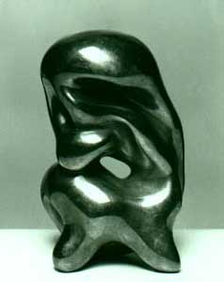
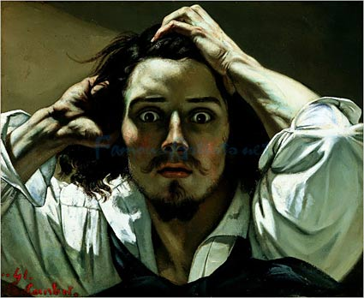
FORM: A 3-dimensional object, or something in a 2 dimensional work that appears 3-dimensional
Gustave Courbet
“The Desperate Man”
Self Portrait
1845 Gustave Courbet
Arp
“Torso of Giant”
1964
Dada

Slide 8
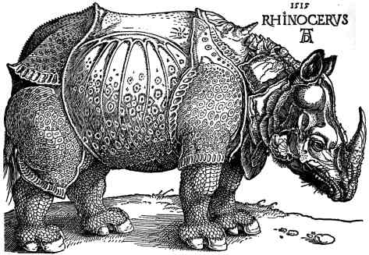
TEXTURE: An element of art, texture is the surface quality or "feel" of an object, its smoothness, roughness, softness, etc. Textures may be actual or implied.
Rhinoceros
Albrecht Dürer
(1471-1528)

Slide 9
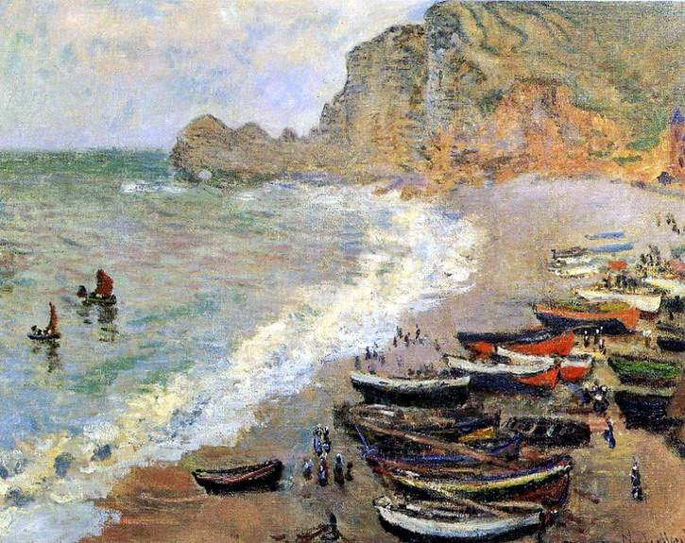
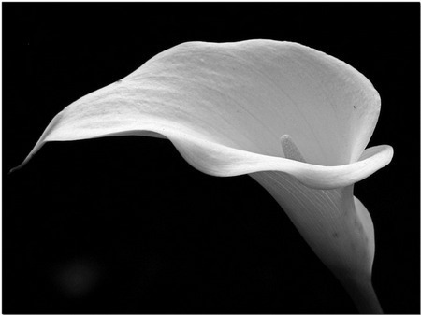
SPACE: An element of art that refers to the distance or area between, around, above, below, or within things. It can be described as two-dimensional or three-dimensional, as flat, shallow, or deep; as open or closed; as positive or negative.
Monet
“Boats on the Beach”
1883

Slide 10
Craftsmanship: Aptitude, skill, and manual dexterity in the use of tools and materials. Neatness
Innovative: New and creative, especially in the way that something is done, not copied
Creativity: The ability to use the imagination to develop new and original ideas or things.
Composition: The way in which the parts of something are arranged.
Proportion: The correct or desirable relationship of size between objects

