Slide 1
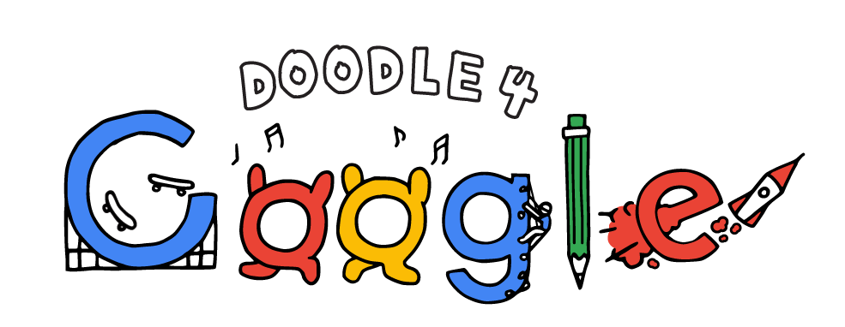
One talented student’s winning artwork will appear on the Google homepage. The winner
will also receive a $30,000 college scholarship and a $50,000 Google for Education
technology grant for their school.

Slide 2
Advice from the Doodlers
https://youtu.be/h0d0VDOoD7k
1st Google doodle ever

Slide 3
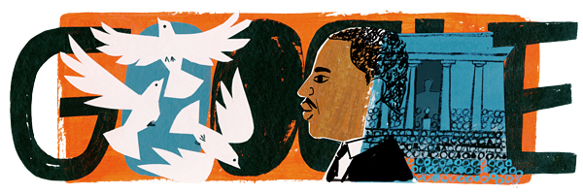
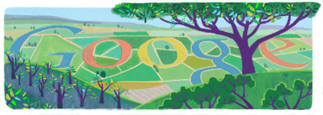
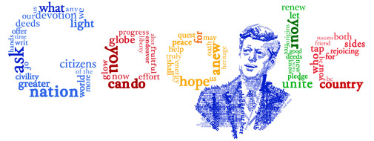
A day in history by Google https://www.google.com/doodles#archive

Slide 4
For the seasons

Slide 5
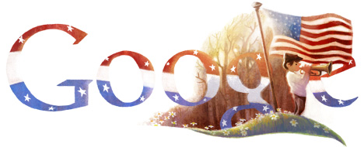
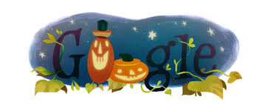
Honors Holidays

Slide 6
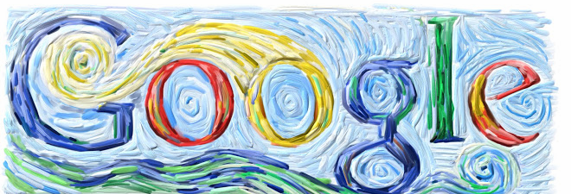
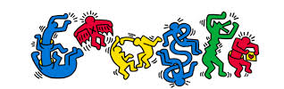
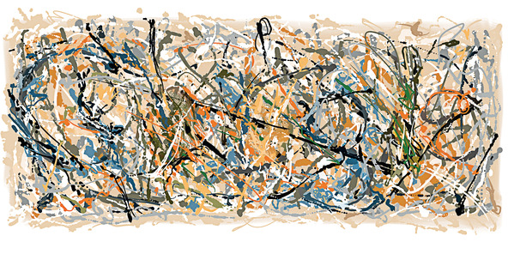
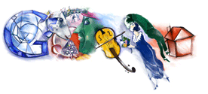
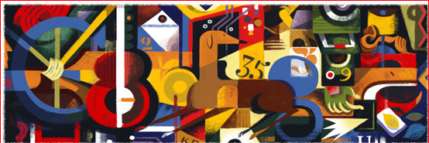
Google honors famous artist

Slide 7
The inspiration behind the doodles
www.google.com/doodles/audrey-hepburns-85th-birthday
www.google.com/doodles/ella-fitzgeralds-96th-birthday
https://www.google.com/doodles/robert-doisneaus-100th-birthday

Slide 8
This years theme
What Makes Me… Me
From cave paintings to selfies, artists have always found creative ways of expressing themselves. Now, with the Google homepage as their canvas, we’re asking students to do the same. Young artists can doodle with any materials to show what makes them unique, and the winner’s artwork will be featured on our homepage for a day.

Slide 9
What makes Me...Me.
Think about your unique qualities.
Who or what inspires you?
What is your greatest success?
What famous person or character do you identify with?
How do you like to express yourself? What makes you happy?
Think globally – This doodle needs to represent a nation not just you.

Slide 10
Items for inspiration
Photographs of favorite things, sports, music, dances, books, magazines, celebrities, tv/ movies, fashion, art, culture, journal entries, nature items, keepsakes, magazine cut-outs, digital print-outs, textiles….
Research fonts to incorporate

Slide 11
Imagine- Create- Share and Collaborate
https://youtu.be/AV6xvIYzP-U
https://youtu.be/ece7e6yLjGc
https://youtu.be/5EOmS3I_aRM

Slide 12
2014 Winners
https://youtu.be/Z080V3YWVDg

Slide 13
Steps for Creation
Brainstorm
Brainstorm
Brainstorm
Research
Research
Research
Create!!!!

